Slide 1

UrbanNest Plaza
Srija Chitikesi
Krishna sai gandi
Shreya thadipaneni

Slide 2
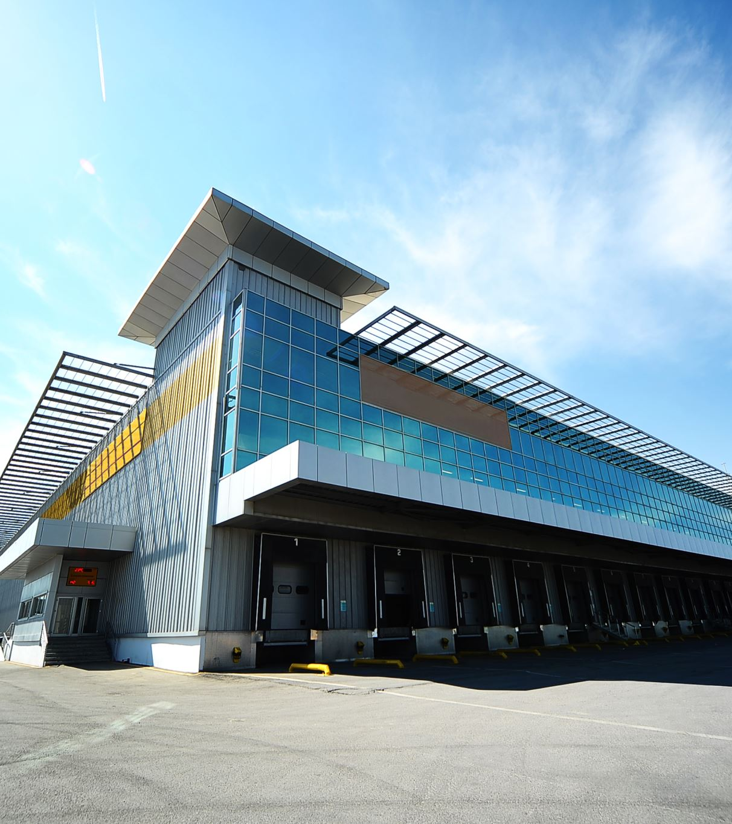
Description
UrabNest Plaza is a web platform developed using HTML, CSS, and JavaScript, with a robust SQL backend, designed to facilitate smooth interactions between property sellers and buyers. The platform offers a user-friendly experience, allowing sellers to list properties through a dedicated dashboard, and buyers to explore and inquire about listed properties. With an emphasis on security, transparency, and efficient real estate transactions, UrbanNest Plaza aims to provide a modern and streamlined experience for users in the real estate market.

Slide 3

Features
Dual-User Access: UrbanNest Plaza offers distinct logins for sellers and buyers, providing tailored experiences for each user type.
Effortless Property Management: Sellers can easily showcase and update property details, while buyers enjoy a user-friendly dashboard to explore and inquire about listings.
Transparent Details: Built-in security measures and transparent features ensure secure dealings between sellers and buyers.
Responsive Design: The platform's responsive layout ensures a seamless experience across devices, allowing users to manage transactions from desktops, tablets, or mobile phones.
Enhanced Real Estate Experience: UrbanNest Plaza is designed to streamline the real estate journey, prioritizing efficiency, transparency, and accessibility for all users involved.

Slide 4
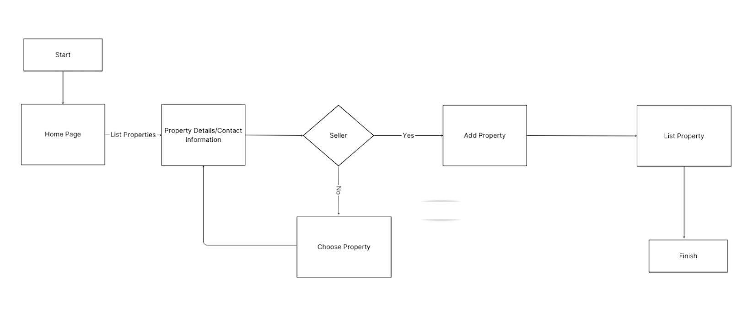
UML Diagram

Slide 5

Navbar
Home – Home page where all properties and resources were provided
About – Details of Each property, seller and buyer
Buy – Buy/Sell Property based on user role

Slide 6
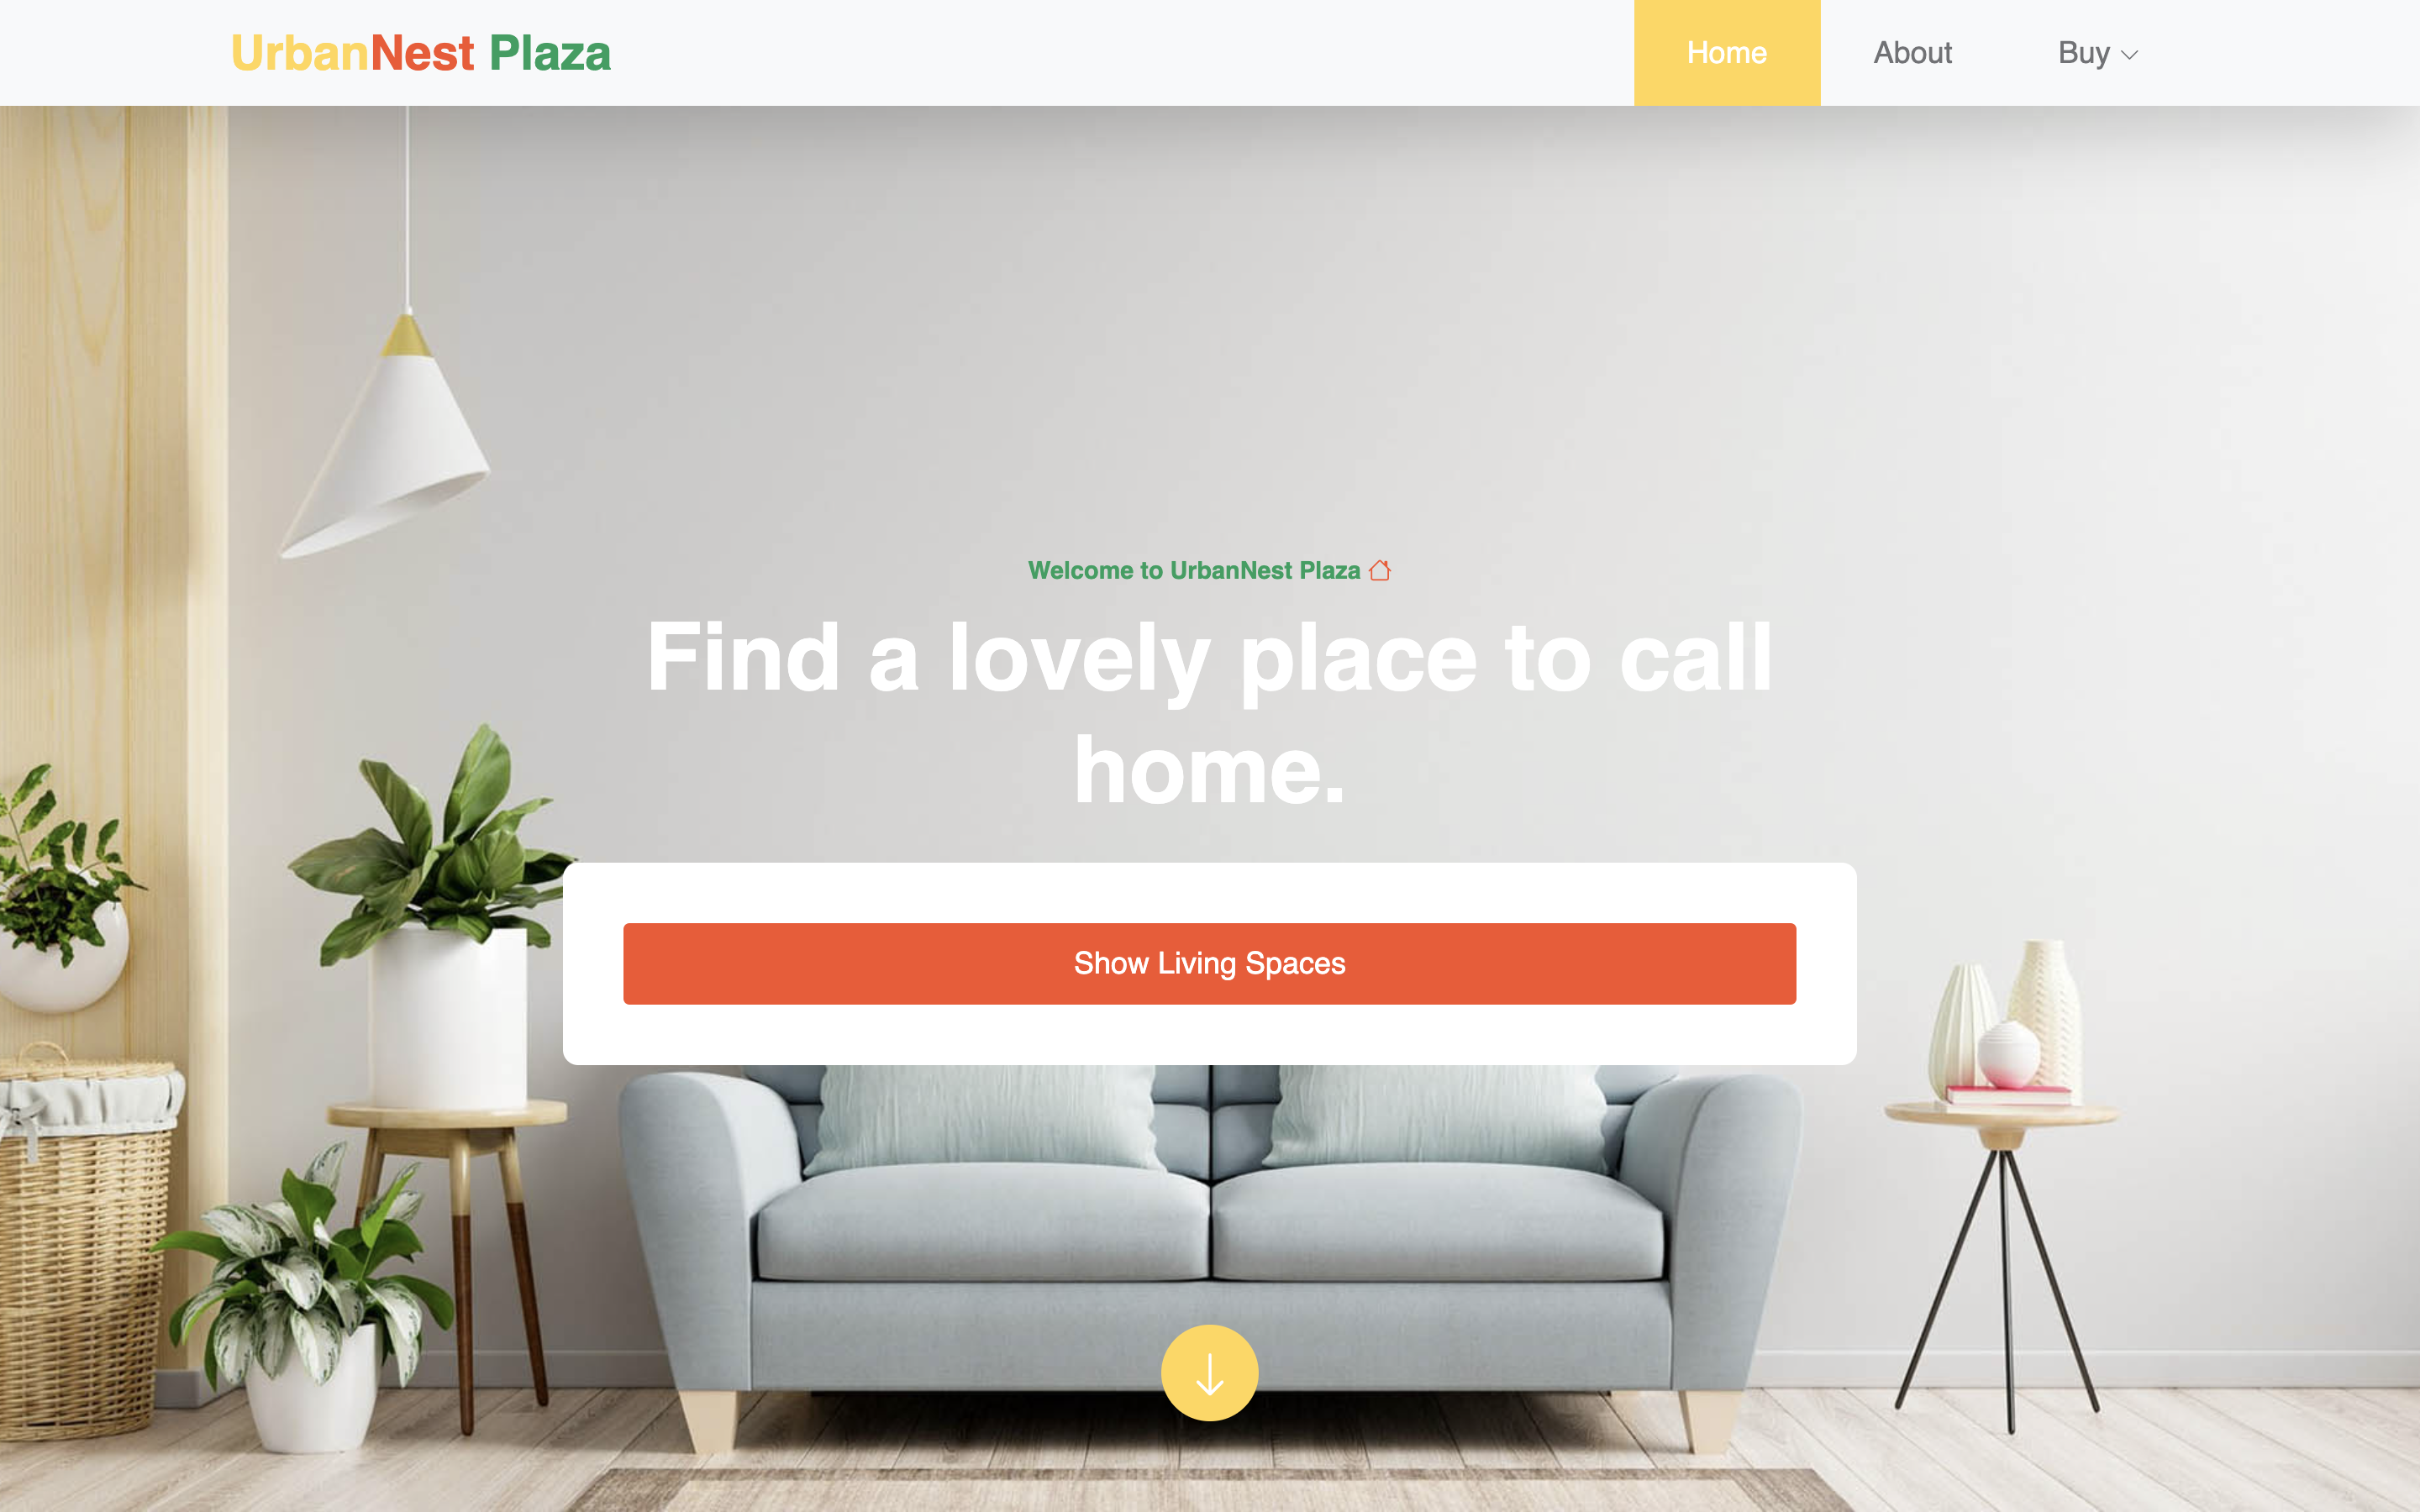
Home Page

Slide 7
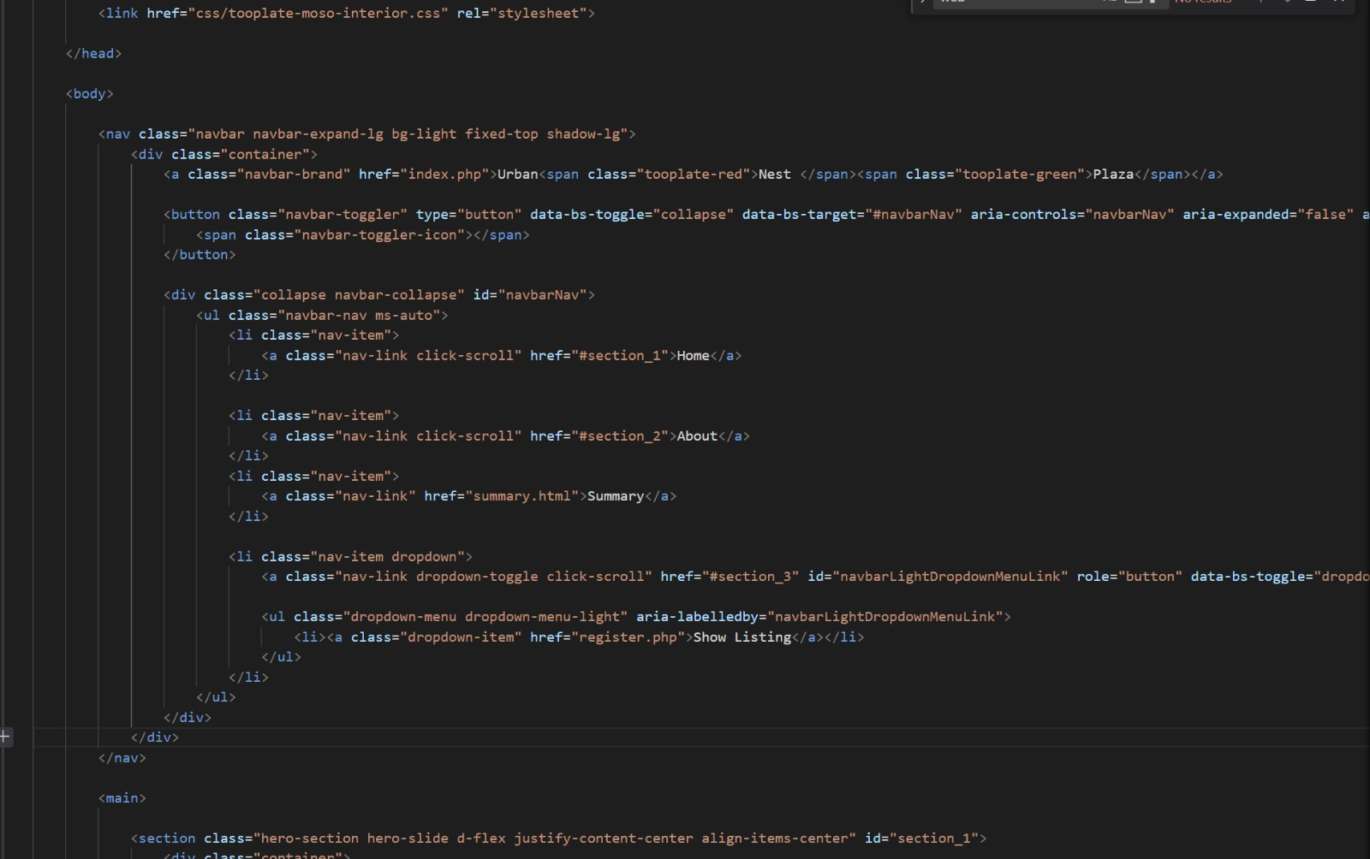
Home Page Code

Slide 8
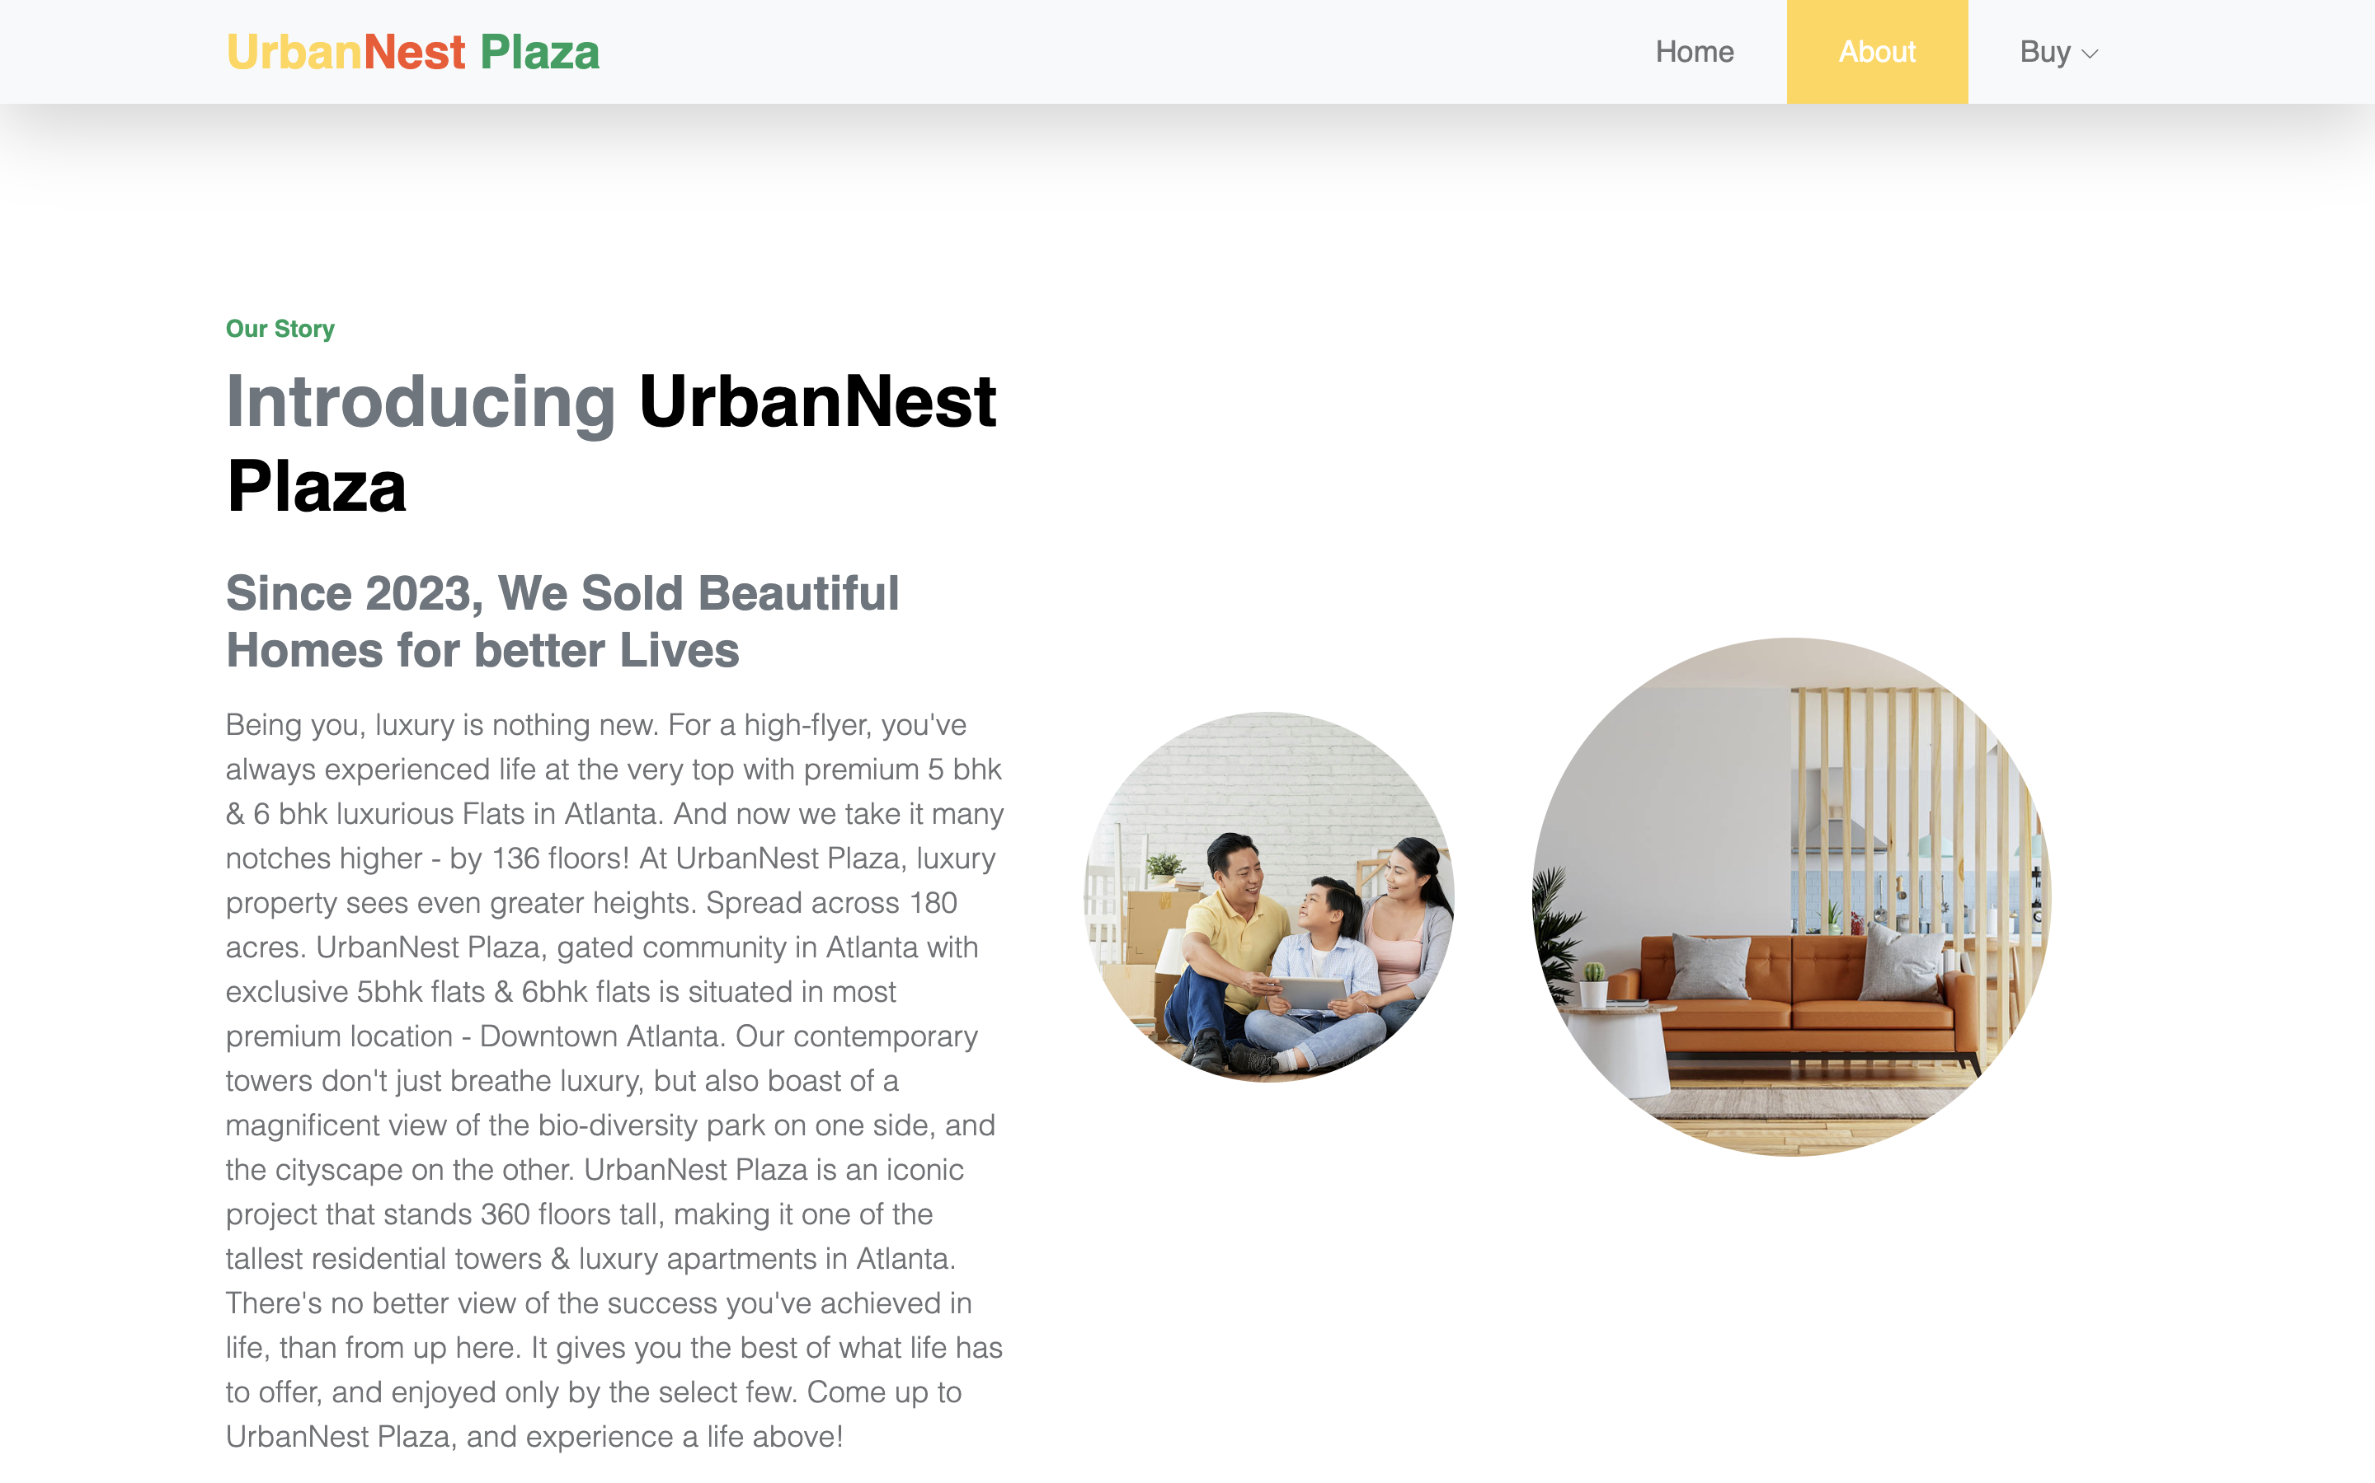
About Page

Slide 9
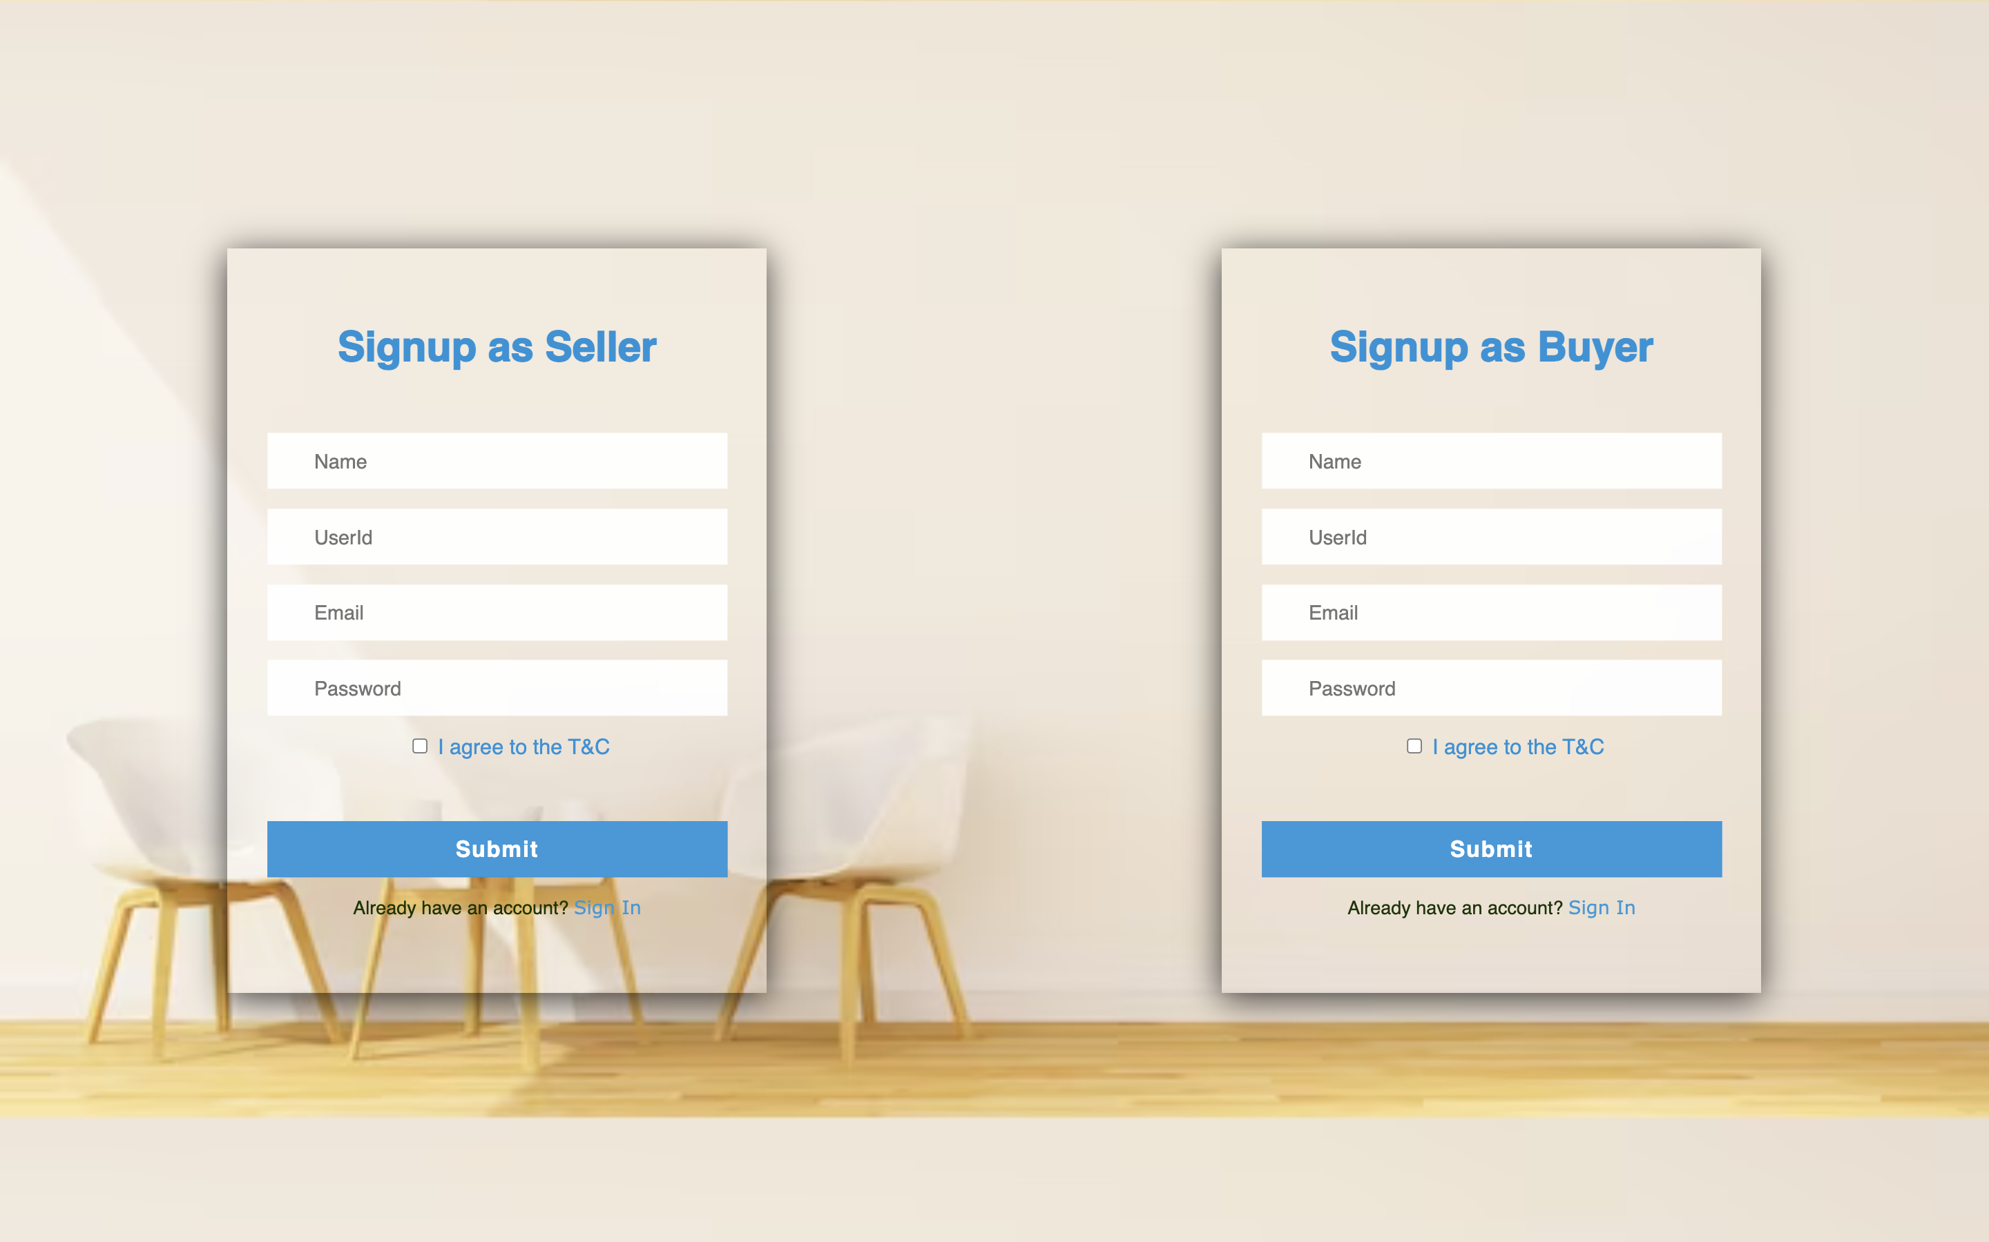
Seller/Buyer Signup

Slide 10
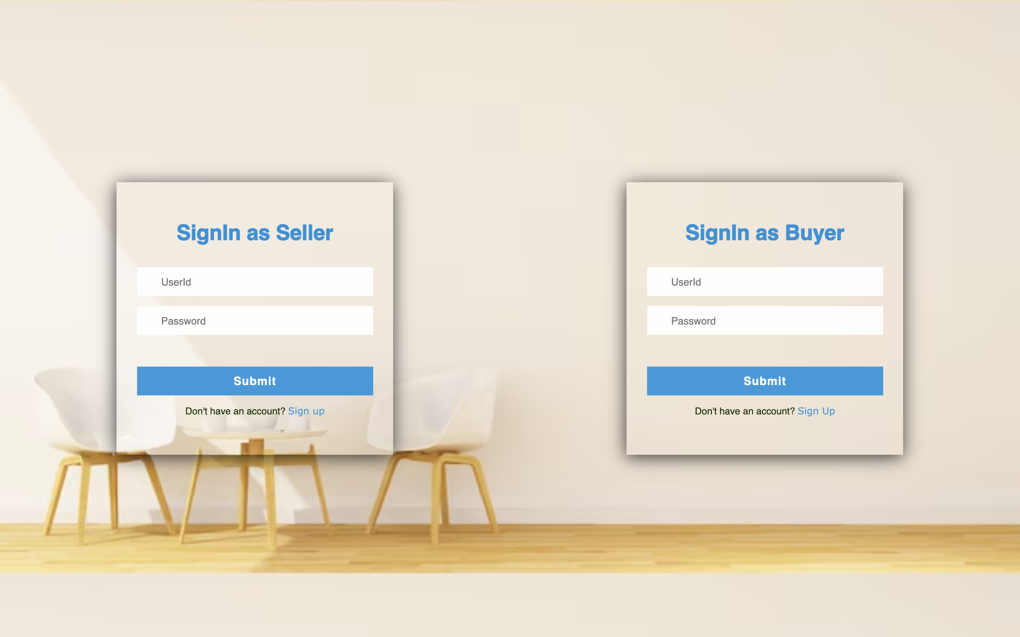
Seller/Buyer Login

Slide 11
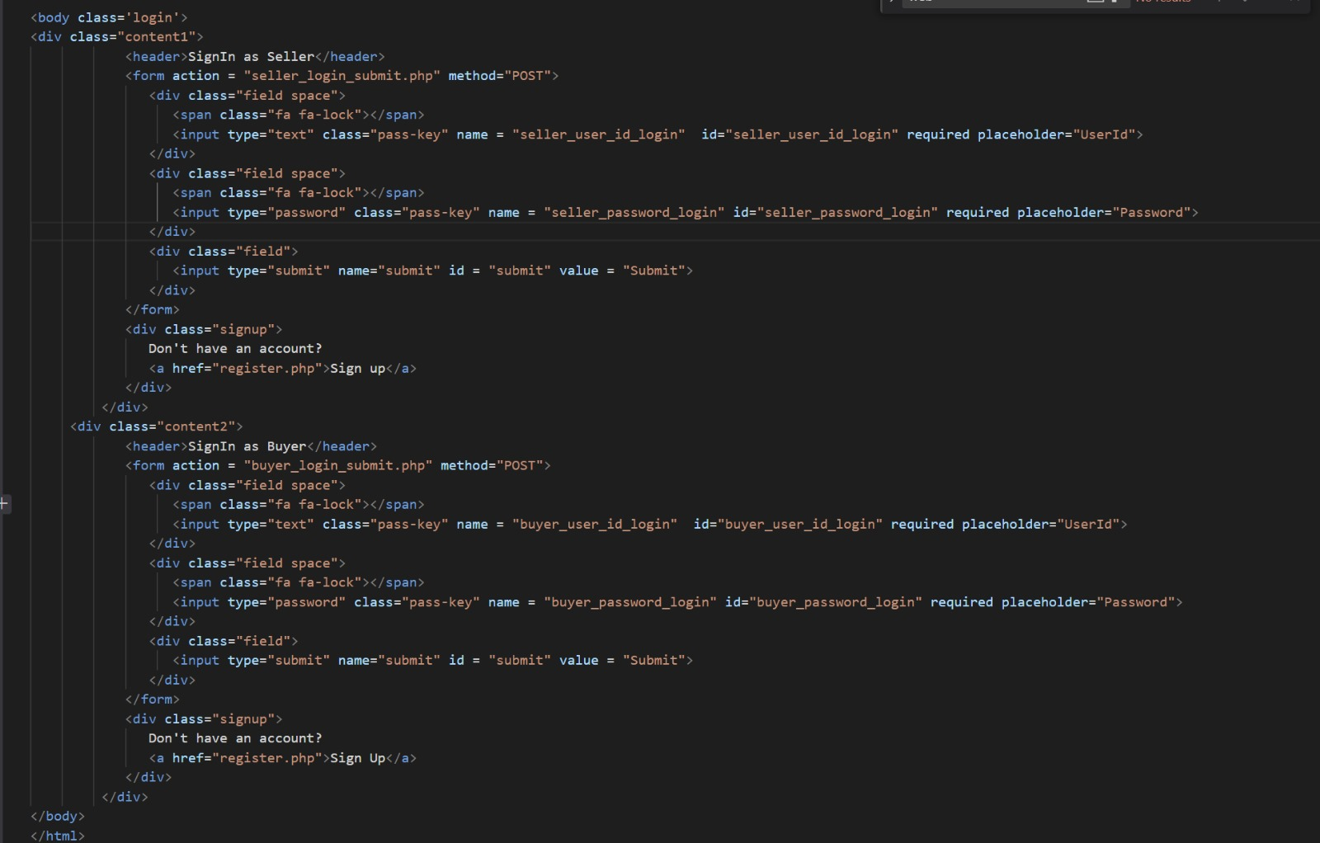
Login Code

Slide 12
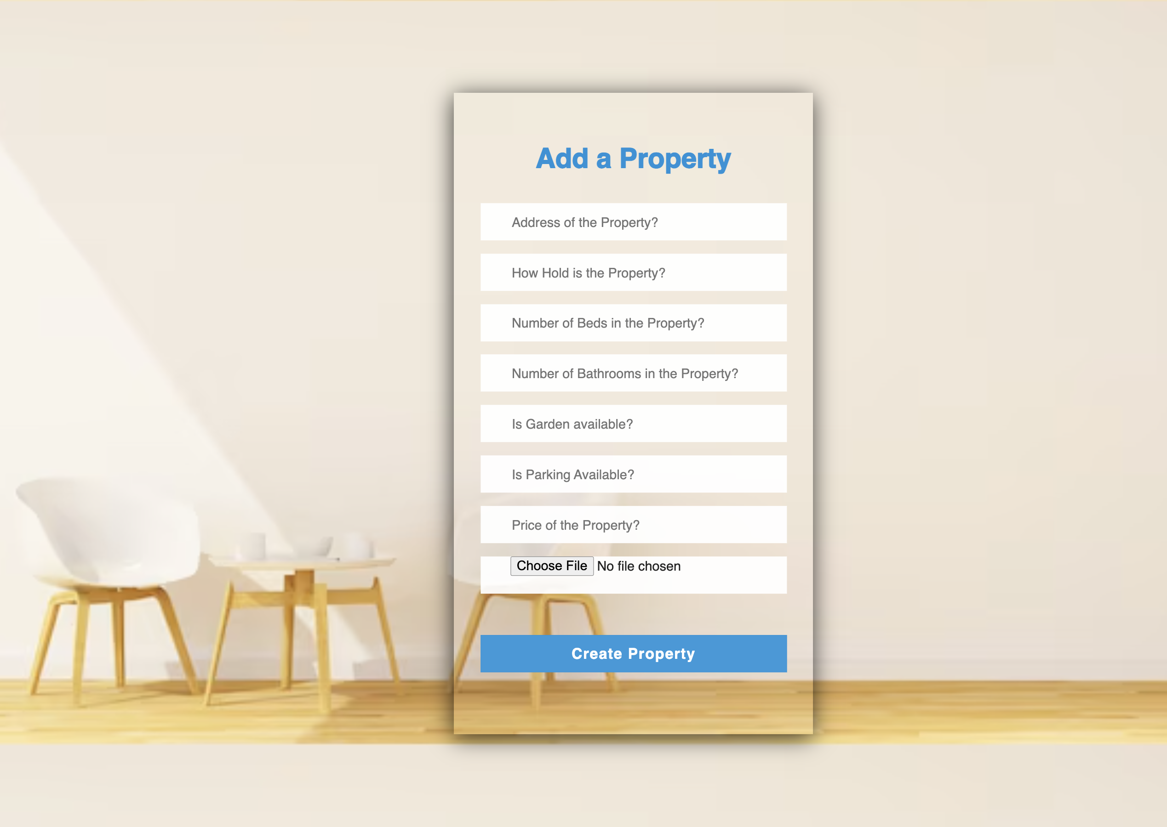
Add Property

Slide 13
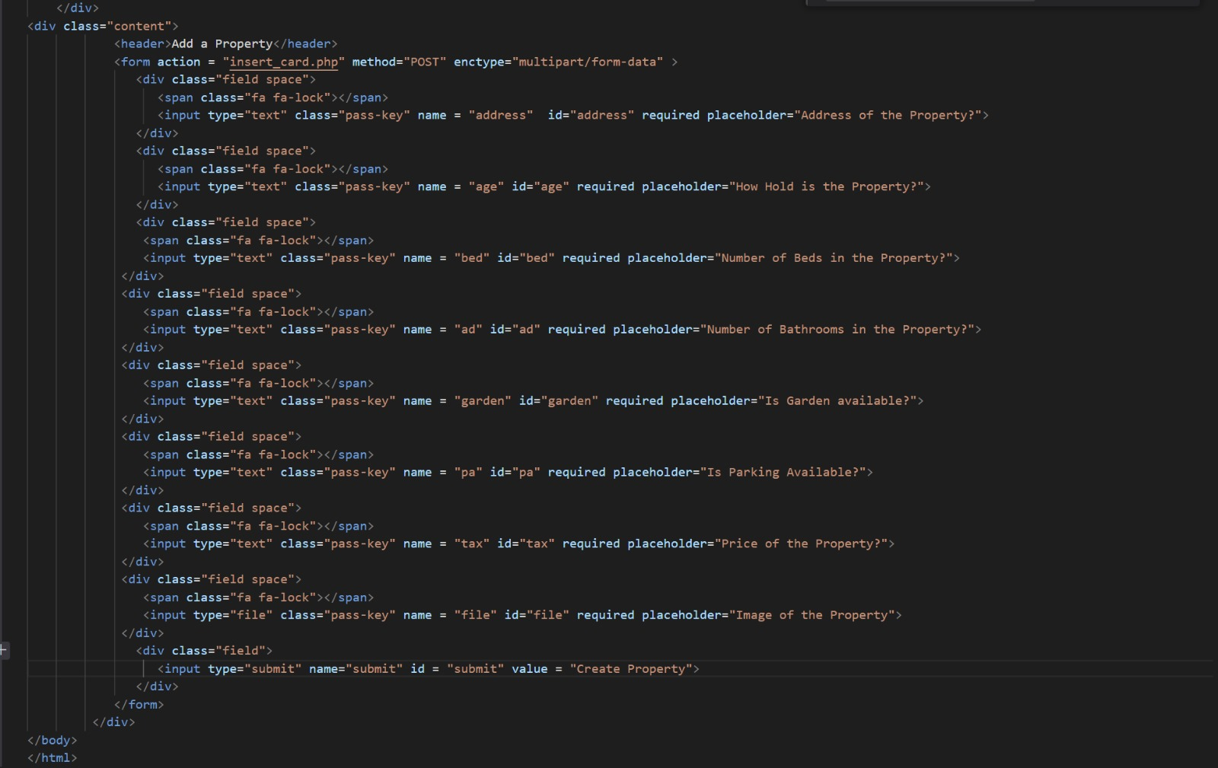
Code for adding property

Slide 14
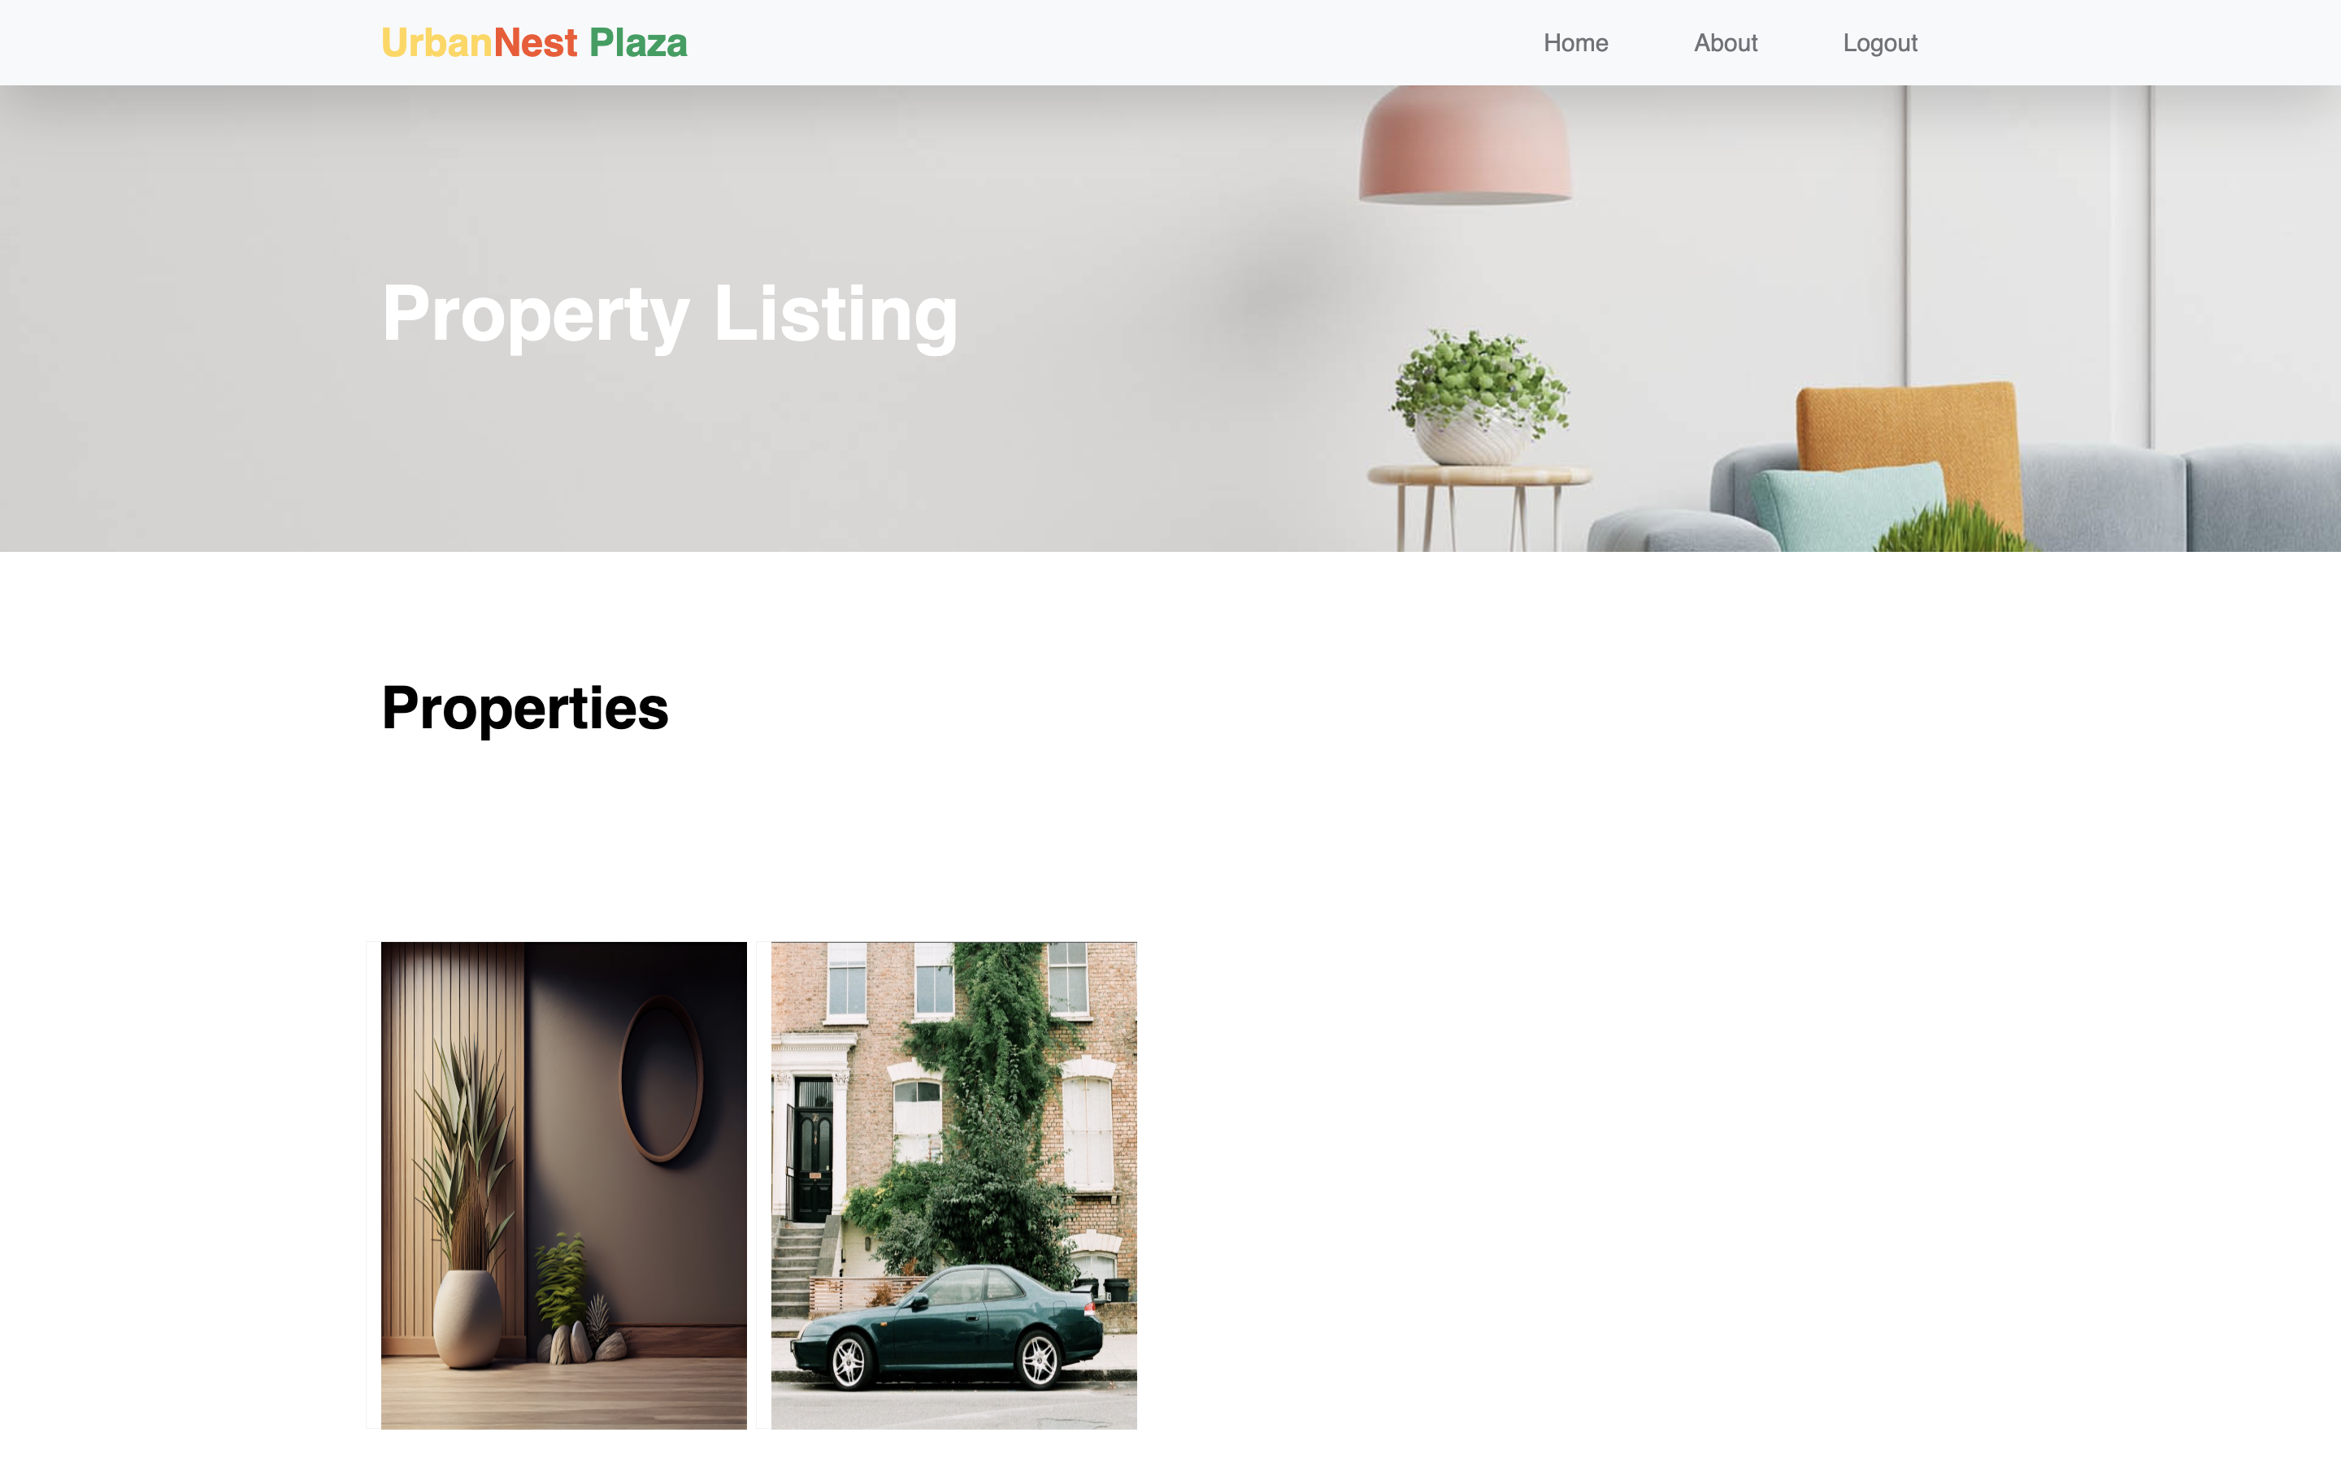
Listing Properties

Slide 15
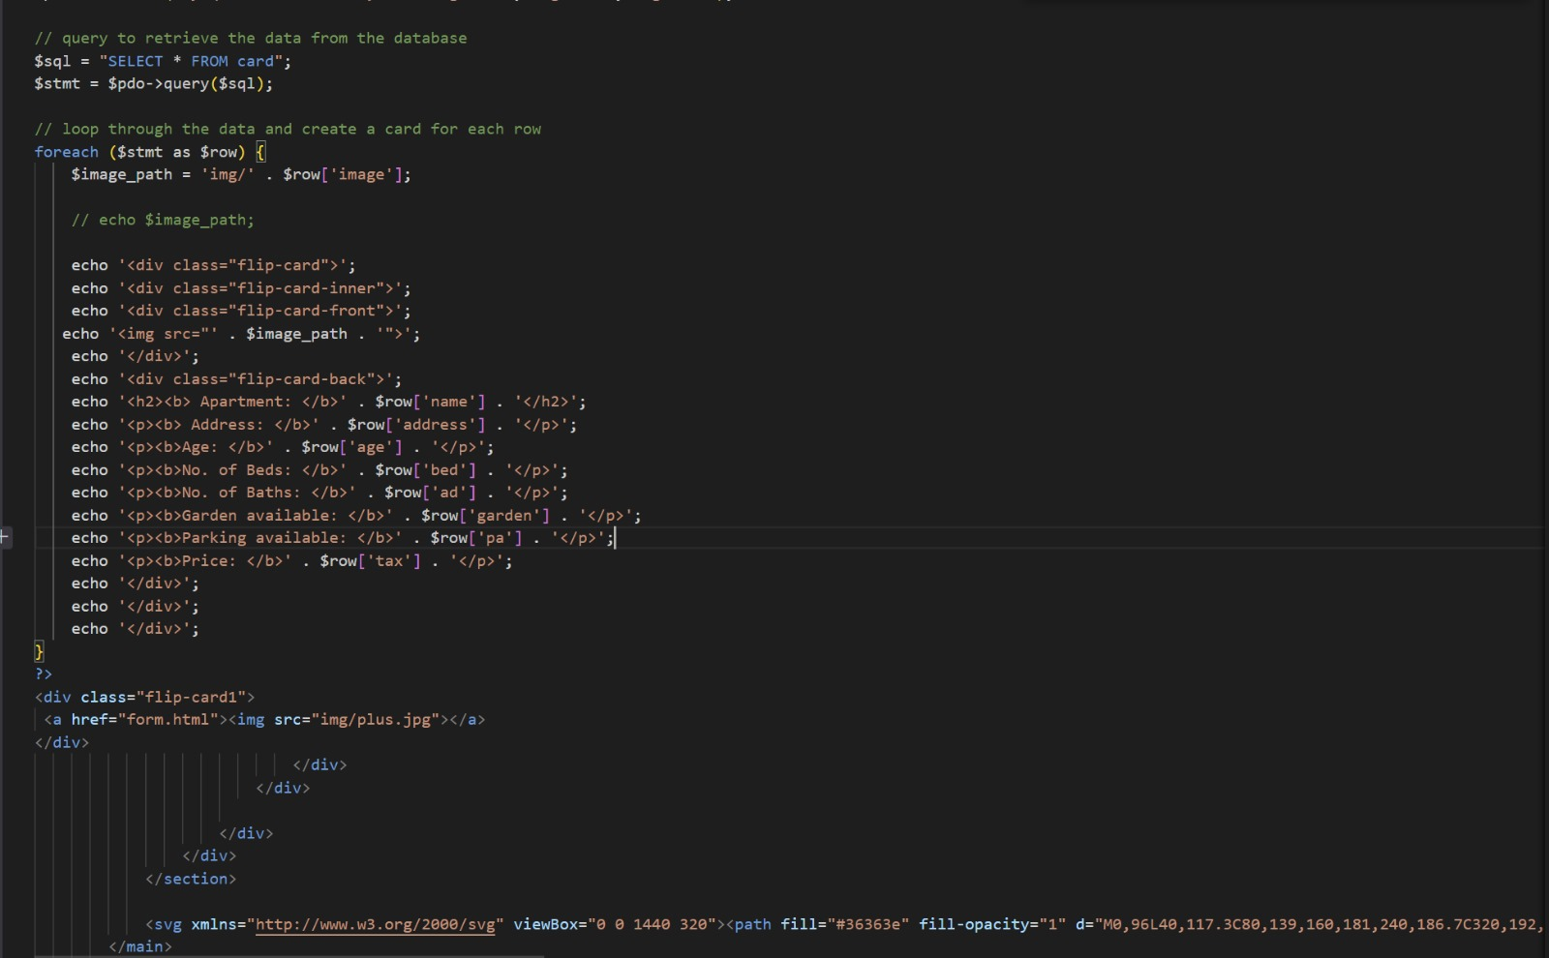
Listing Properties Code

Slide 16
Testing
Chrome
Safari
Internet Explorer
Edge
Codd

Slide 17
Links
Codd – https://codd.cs.gsu.edu/~schitikesi1/WP/PW/4/
Youtube – https://youtu.be/U6o6HUvTa0s
Github - https://github.com/gkrishnasai16/Web-Programming-Final-Project

Slide 18

Thank you

